Slide 1
TAK Server Certificate Enrollment/Revoking

Slide 2
Certificate Enrollment - Hard vs Soft
With the makeCert.sh we are creating "Soft" certificates which are manually generated followed by the UserManager.jar placing the certificate in a group.
You would need to pass the user both the trust store certificate and the user certificate for them to be able to connect.
The other method is "Hard", using certificate enrollment where the client gets its certificate directly from the server and is placed in the group automatically.
By selecting the auto enrollment feature when connecting to the server you only need to enter in the IP address and then enter the credentials.
Unless you don’t have a public facing domain, then you will need to pass the user the trust store cert.

Slide 3
Certificate Auto Enrollment
Identify our signing truststore
ls -l /opt/tak/certs/files/*-signing.jks
Navigate to your TAK Server admin dashboard on a browser
Navigate to: Hamburger menu → Configuration → Security and Authentication
Under the Security Configuration section select the “Edit Security” option.
Enable the “Enable Certificate Enrollment” option and then enable the “TAK Server CA” option.
Fill in the following:
Signing Keystore File = certs/files/<CACommonName>-signing.jks
the common name if the one we identified as our signing truststore above.
Signing Keystore Password = Default: atakatak (if you changed the password in the cert-metadata.sh file that would go here.)
Validity Days: Leave as default or change to how many days the certificate should be valid for.
After all those are filled in click “submit”
Restart the server:
sudo systemctl restart takserver
Notes:
# Setting this up allows for the TAK Server to issue certificates to clients upon successful authentication. The server will store the client credentials.
# By submitting this we are appending new elements in our CoreConfig.xml file identified by the certificateSigning block.

Slide 4
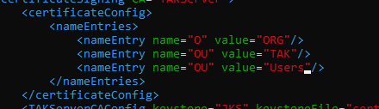
Certificate Auto Enrollment - Command Line
To change the name of the server values:
Enter the “tak” user
sudo su tak
Change the directory to the tak directory
cd /opt/tak
Edit the CoreConfig.xml file
vi CoreConfig.xml
Scroll down to find the following:
modify the “TAK” value to your desired output.
O = Organization
OU = Organization Unit
Notes:
# If you noticed we applied the changes directly to the CoreConfig.xml file and not the CoreConfig.example.xml file. This ensures we have a working backup, but if you know the changes are good you can overwrite the CoreConfig.example.xml file.
# If you want to be an over achiever you can make the changes to the CoreConfig.xml file. I highly recommend you create a backup copy of the /opt/tak directory encase you royally screw up.
# Reminder: anytime you make changes to the CoreConfig.xml file you need to restart to apply these changes.
# vi = Visual Interface Vim is an extension of vi with for features.

Slide 5
Certificate Auto Enrollment - Command Line
In the same text editor, we need to add CAkey and CAcertificate to the TAKServerCAConfig line to support revokations.
<TAKServerCAConfig keystore="JKS" keystoreFile="certs/files/TAK-ID-CA-01-signing.jks" keystorePass="atakatak" validityDays="30" signatureAlg="SHA256WithRSA" CAkey="/opt/tak/certs/files/<CAcommonName>" CAcertificate="/opt/tak/certs/files/<CAcommonName>"/>
Example: <TAKServerCAConfig keystore="JKS" keystoreFile="certs/files/TAK-ID-CA-01-signing.jks" keystorePass="atakatak" validityDays="30" signatureAlg="SHA256WithRSA" CAkey="/opt/tak/certs/files/TAK-ID-CA-01" CAcertificate="/opt/tak/certs/files/TAK-ID-CA-01"/>

Slide 6
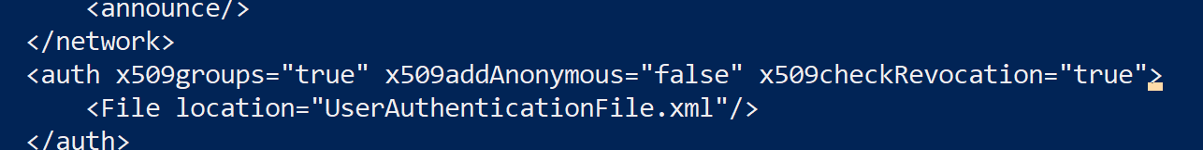
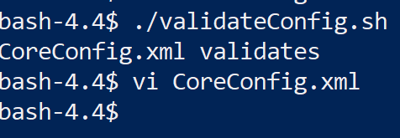
Certificate Auto Enrollment
Lastly we need to add the following line to our <auth> element:
x509checkRevocation=“true”
Save and Exit
To verify our changes run the following:
./validateConfig.sh
Exit the tak user
exit
Restart the takserver.service
sudo systemctl restart takserver.service
Monitor the logs for errors
tail -f /opt/tak/logs/takserver-messaging.log

Slide 7

Enrolling Clients with Auto Enrollment
In the admin dashboard open the following: Hamburger menu → Administrative → Manage Users
Click on “Add User”
fill in the details and select “Create New User”
The certificate enrollment process is communicated to the server over TCP port 8446, which is not enabled by default.
Check if the port is already enabled:
sudo firewall-cmd --list-all
Enable 8446 Certificate enrollment port.
sudo firewall-cmd --zone=public --add-port 8446/tcp --permanent
Reload the firewall to apply the changes
sudo firewall-cmd --reload
Notes:
You can create multiple users at once through the user manager on the TAK Server dashboard.
When creating multiple users, the passwords will be auto generated and stored in a text file that is automatically downloaded.

Slide 8
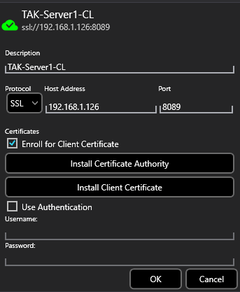
Connecting ATAK to TAK Server
Select the hamburger menu in the top right
Scroll down and select settings
Select “Network Preferences”
Select “Tak Servers”
In the top right select the three dots and then “Add”
Name:<name you like for the server>
Address:<IP address>
Enable “Enroll for Client Certificate”
Select “Ok”
Note: If you are trying to connect to the TAK Server without setting up the public facing domain you need to pass the truststore cert as well or create a data package.
Enter in the user credentials that you create from the admin dashboard

Slide 9
Soft Certificate Management
Switch to the “tak” user
sudo su tak
navigate to the cert's directory
cd /opt/tak/certs
Create client certificate
./makeCert.sh client <ClientName>
Example: ./makeCert.sh client wintak
Add the client to a group
java -jar /opt/tak/utils/UserManager.jar certmod -g __ANON__ /opt/tak/certs/files/<commonName>
Example: java -jar /opt/tak/utils/UserManager.jar certmod -g __ANON__ /opt/tak/certs/files/wintak.pem
We need to place them in a group or else they will not be available in the dashboard.
If you would like to create a new group for the user, you can replace “__ANON__” with the new group
Notes:
# We successfully created a new user, which can be seen from the admin dashboard -> hamburger menu -> administrative -> manage users.
# You can create a user from the command line but will still need to give them a default password on the TAK Server dashboard to allow them to connect

Slide 10
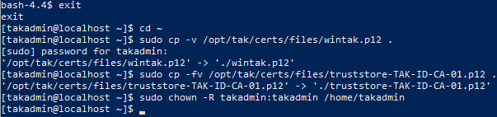
Soft Certificate Management
Copy the files to move to our admin workstation
Exit the tak user
exit
Change the directory to the home directory
cd ~
Copy our client and public CA certificates
sudo cp -v /opt/tak/certs/files/wintak.p12 .
sudo cp -v /opt/tak/certs/files/truststore-<public CA name>.p12 .
Example: sudo cp -v /opt/tak/certs/files/truststore-TAK-ID-CA-01.p12 .
Note: if you already have the truststore cert downloaded you do not need to do it again.
Restore ownership of the files to the home directory.
sudo chown -R takadmin:takadmin /home/takadmin

Slide 11
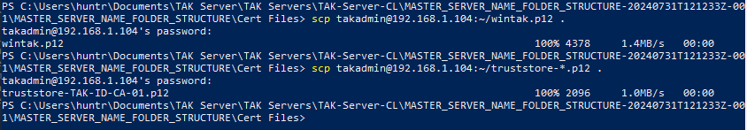
Soft Certificate Management
Download the files from your Linux machine to your local machine.
Navigate to the folder location you want to certificates to be stored and open a terminal at this location.
Copy over the files:
scp <username>@<IP address>:~/<file> .
Example: scp takadmin@192.168.1.104:~/wintak.p12 .
Example: scp takadmin@192.168.1.104:~/truststore-*.p12 .

Slide 12
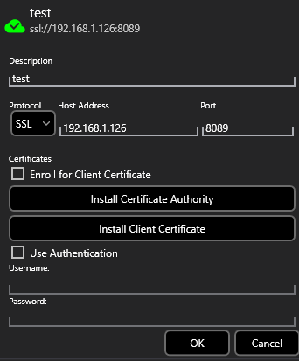
Soft Certificate Management - Connecting
To connect to the TAK Server from a TAK device you will need both the client cert and the truststore cert downloaded on the device.
Once in the TAK devices “Manage Server Connections” section you will select “Add Item”
You will then fill in all the necessary information and import the certificate authority (truststore cert) and the client cert.
With both these certs you will not need to authenticate when connecting to the server.

Slide 13
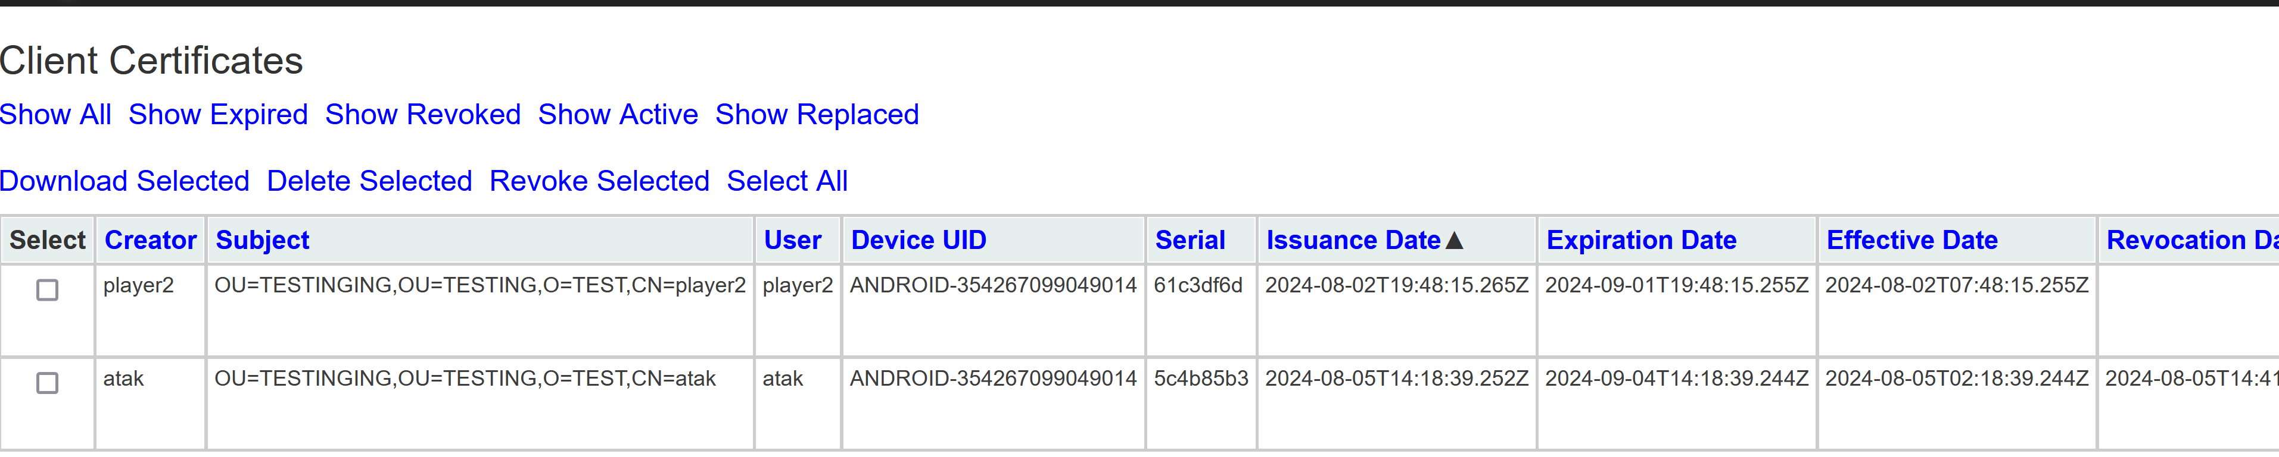
Revoking Certificates - Server Dashboard
If the server is configured for certificate autoenrollment we can revoke certificates from the server dashboard.
From the server dashboard → hamburger menu → administrative → Client Certificates
You can check the certificates you want to revoke then select the “Revoke Selected” option at the top.
You can also go the cert you want to revoke and select revoke on the far right of that cert.
You will get a warning about the server needing to restart to update the CRL (Certificate Revocation List).
Notes:
# When you revoke a certificate from this dashboard you will need to restart the tak server service.

Slide 14
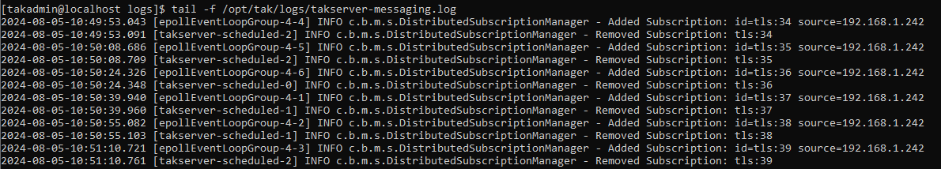
Revoking Certificates - Server Monitoring
When the server restarts you can monitor the log file (takserver-messaging.log) to see the server revoking the client.
2024-01-17-20:26:27.758 [epollEventLoopGroup-4-1] ERROR c.b.m.nio.codec.impls.X509AuthCodec - X509 auth exception info: CN: myTeckNet. Message: Attempt to use revoked certificate : OU=TAK,O=TAK,CN=myTeckNet com.bbn.marti.remote.exception.RevokedException: Attempt to use revoked certificate : OU=TAK,O=TAK,CN=myTeckNet at com.bbn.marti.groups.X509Authenticator.auth(X509Authenticator.java:134) ...
2024-01-17-20:26:27.760 [epollEventLoopGroup-4-1] ERROR c.b.m.nio.codec.impls.X509AuthCodec - TakException in doTlsAuth Attempt to use revoked certificate : OU=TAK,O=TAK,CN=myTeckNet com.bbn.marti.remote.exception.RevokedException: Attempt to use revoked certificate : OU=TAK,O=TAK,CN=myTeckNet at com.bbn.marti.groups.X509Authenticator.auth(X509Authenticator.java:134)
You will also see the server attempt to add the client then immediately remove it, incrementing the “id=tls” every time.
2024-01-17-20:45:07.106 [epollEventLoopGroup-4-2] INFO c.b.m.s.DistributedSubscriptionManager - Added Subscription: id=tls:19 source=192.168.178.177
2024-01-17-20:45:07.108 [takserver-scheduled-1] INFO c.b.m.s.DistributedSubscriptionManager - Removed Subscription: tls:19
Notes:
# TLS: transport layer security

Slide 15
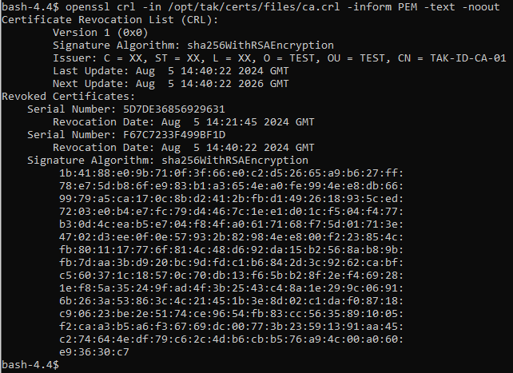
Certificate Revocation List
View the contents of the CRL file
openssl -crl -in /opt/tak/certs/files/ca.crl -inform PEM -text -noout
Search the list for a revoked certificate
openssl -crl -in /opt/tak/certs/files/ca.crl -inform PEM -text -noout | grep <revokedSN>
Example: openssl -crl -in /opt/tak/certs/files/ca.crl -inform PEM -text -noout | grep 5D7DE36856929631
Notes:
# The following certificates are the ones that were created using the makeCert.sh client command.
# in -crl is coming back as an invalid command run crl instead.

Slide 16
Revoking Clients - Publish the Revoked Certificate - Command Line
Switch to the tak user
sudo su tak
Change the directory to the tak directory
cd /opt/tak
Edit the CoreConfig file
vi CoreConfig.xml
Look for the following area of code towards the bottom of the file.

Slide 17
Revoking Clients - Publish the Revoked Certificate - Command Line
At the end of the “tls” line remove the “/”.
On a new line add the following line of code:
<crl _name=“TAKServer CA” crlFile=“certs/files/<your CA>.crl”/>
Example: <crl _name=“TAKServer CA” crlFile=“certs/files/TAK-ID-CA-01.crl”/>
Add a closing statement for tls element on a new line.
</tls>
Save and exit the file.
press the “esc” key
type the following:
:wq!
press enter

Slide 18
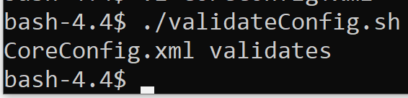
Revoking Clients - Publish the Revoked Certificate - Command Line
Validate the file.
./validateConfig.sh
Once validated exit the tak user
exit
Restart the server
sudo systemctl restart takserver.service
You can monitor the server on restart to verify there are no errors:
sudo tail -f /opt/tak/logs/takserver-messaging.log
Notes:
# The standard procedure is to revoke the client and then remove the user account to prevent future authentication attempts.

Slide 19
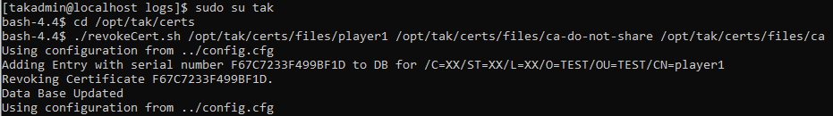
Revoking Certificates - Command Line
Determine the certificate issuing signing certificate authority
openssl x509 -text -in /opt/tak/certs/files/<commonName>.pem | grep -Eo "Issuer:.+“
Example: openssl x509 -text -in /opt/tak/certs/files/revokedClient.pem | grep -Eo "Issuer:.+“
Revoke the Client:
Change to the tak user
sudo su tak
Change directories to the certificate directory
cd /opt/tak/certs
Revoke the targeted cert
./revokeCert.sh /opt/tak/certs/files/<commonName> /opt/tak/certs/files/ca-do-not-share /opt/tak/certs/files/cat
Example: ./revokeCert.sh /opt/tak/certs/files/revokedClient /opt/tak/certs/files/ca-do-not-share /opt/tak/certs/files/ca
Notes:
# Revoking a certificate is used when we want to prevent access to a client before the expiration data or when a client no longer requires access.
# We need to know some information regarding the client: certificates common name, who signed the certificate, and the private key associated with the signing cert authority.
# The following is for revoking clients using the revokeCert.sh client command.
# If you logged in and select auto enrollment for the user then you will need to revoke them from the server dashboard.

